Slide 1
Open source component audit in DevSecOps
DevOps Kathmandu meetup – 14th
2nd August 2020

Slide 2
About me
@thinksabin
thinksabin

Slide 3
Contents
Open source component analysis
Software supply chain attacks
DevSecOps pipeline
Tools
Sample Demo: OWASP DependencyTrack, CycloneDx

Slide 4
component Analysis
Figuring the components/ ingredients of your software
Analysis could base on many factors like:
License, version, vulnerabilities, EOL, etc.
Components impact your software life cycle and maintenance cycle

Slide 5
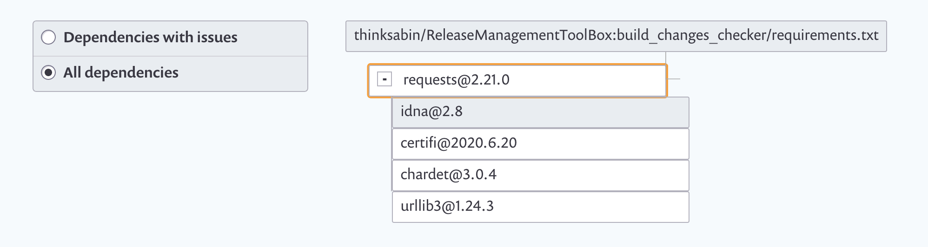

Slide 6
Lookup into the open source communities:
Nodejs: 836k+ libraries
Python: 250k+ project in PyPi
Java: ??
Ruby: ?? ..
Modern software includes code from strangers

Slide 7
Software Supply chain attacks
Using the flaws in your application’s dependencies
Hard to address due to the complexities of the applications
OWASP Top Ten 2017 A9: Using component with known vulnerabilities
Example incidents:
Magecart use of malicious javascript code to copy CC data
Strong_passsword 0.0.7 ruby gem hijacks
Grayfish attacks on hardware

Slide 8
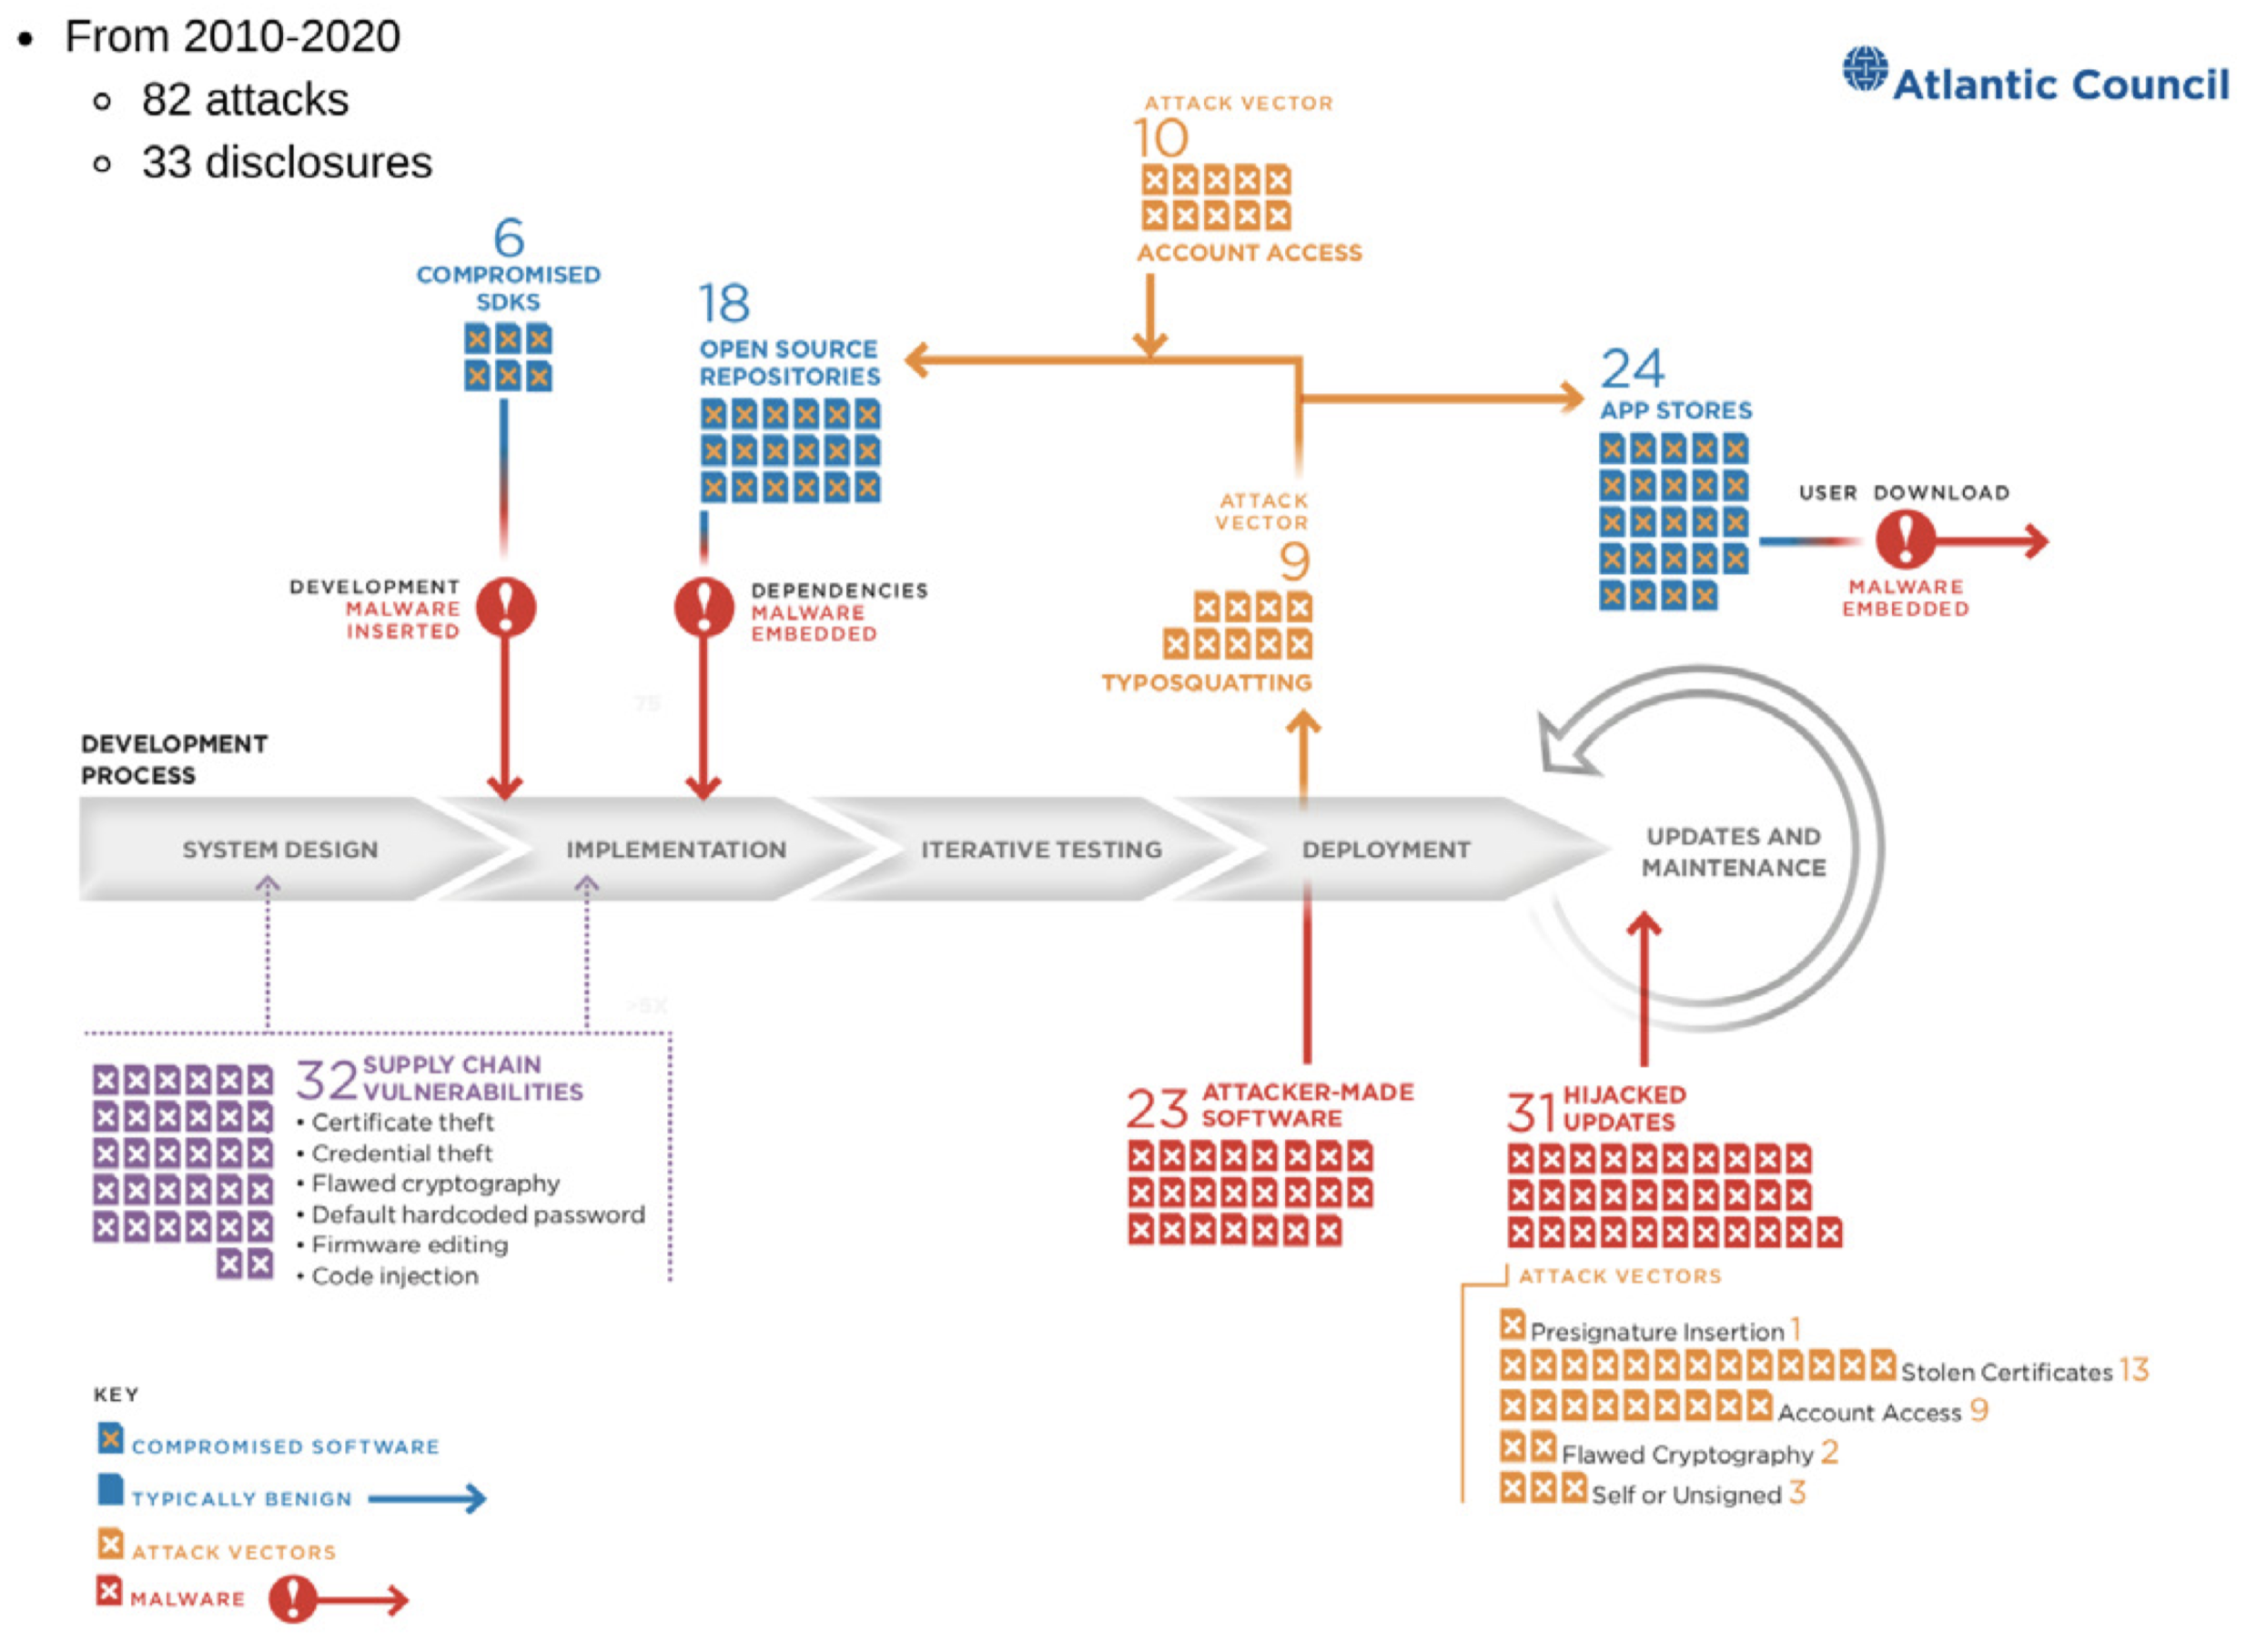

Slide 9
SBOM
Software bill of material
OWASP Software Component Verification Standard
Designed to help perform risk analysis
Formatted in XML or JSON
Specification may differ based on the community practices.
Eg: OWASP CycloneDX, SPDX, ..
Tools: OWASP DependencyTrack, Sonatype, Snyk, ..

Slide 10
In January 2019, new PCI secure development standards advise organizations to generate an SBOM to track and trace the location of every single component.
A function within an overall Cyber Supply Chain Risk Management (C-SCRM) framework
By 2024, the provision of a detailed, regularly updated software bill of materials (SBOM) by software vendors will be a non-negotiable requirement for at least half of enterprise software buyers, up from less than 5% in 2019. – Gartner Appsec Tools report.

Slide 11
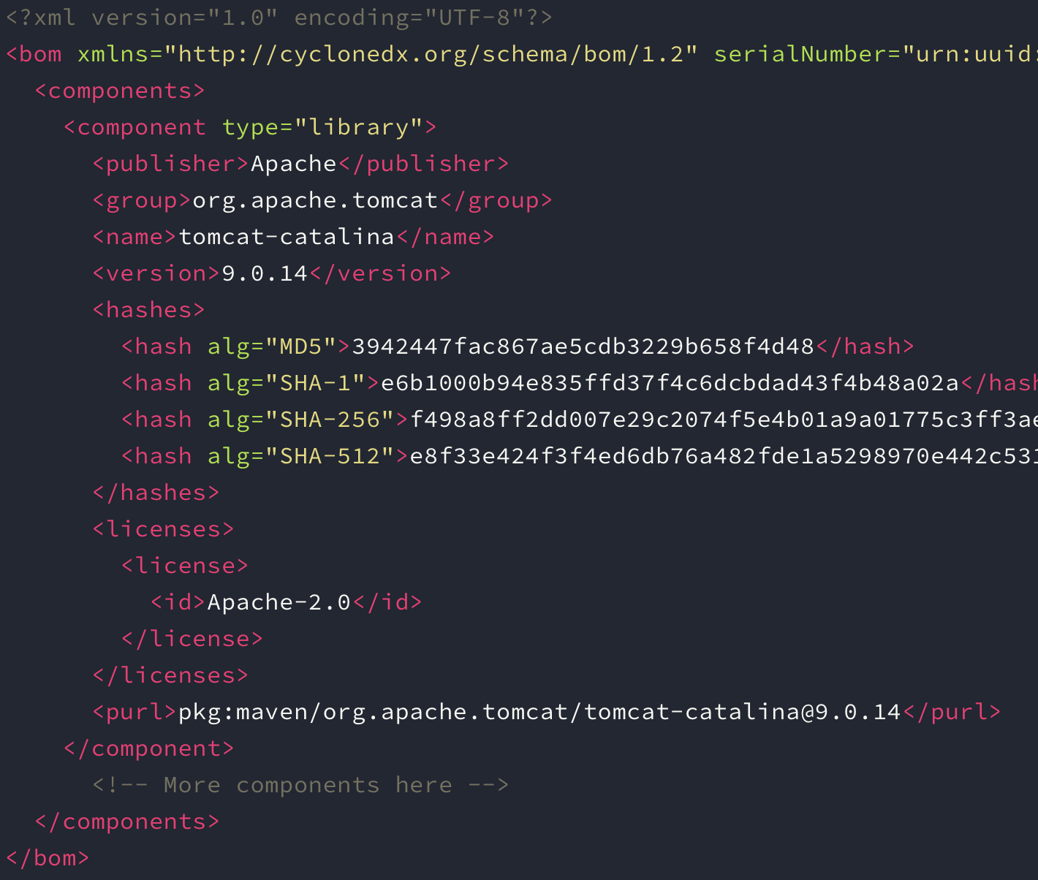

Slide 12
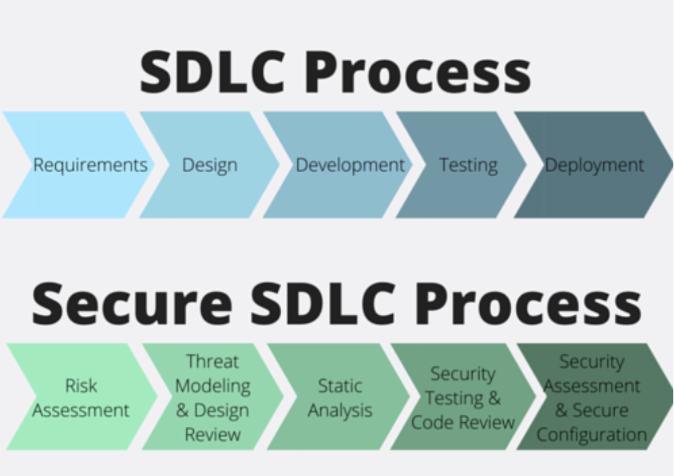
DevSecOps
Embedding application security into the software development
Secure SDLC in the Agile and DevOps world.
Shift left

Slide 13
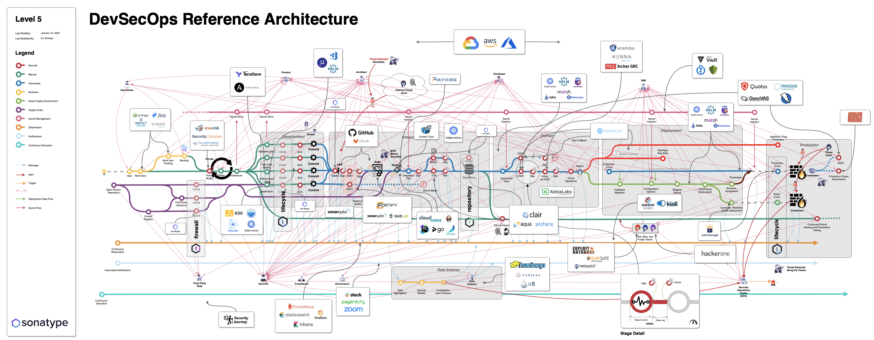

Slide 14
SBOM for Secure CI
Know your product deeply
Build secure artifacts
Performed Risk analysis – resolved, mitigated, transferred, accepted, etc.
OWASP CycloneDX
Massively used in the communities.
Auditjs, Chelsea, Shiftscan, Jake, Retirejs, ..

Slide 15
Demo
OWASP CycloneDX
OWASP DependencyTrack

Slide 18
References and more studies:
https://cyclonedx.org
https://docs.dependencytrack.org
https://csrc.nist.gov/projects/cyber-supply-chain-risk-management
https://www.atlanticcouncil.org/wp-content/uploads/2020/07/Breaking-trust-Shades-of-crisis-across-an-insecure-software-supply-chain.pdf
https://secureteam.co.uk/articles/web-application-security-articles/what-are-software-supply-chain-attacks/

Slide 19
https://withatwist.dev/strong-password-rubygem-hijacked.html
https://securityboulevard.com/2020/04/using-components-with-known-vulnerabilities-2/
https://owasp.org/www-project-software-component-verification-standard/
https://blog.sonatype.com/why-you-need-a-software-bill-of-materials-more-than-ever
https://www.sonatype.com/2020survey
https://blog.sonatype.com/software-bill-of-materials-going-mainstream
https://www.it-cisq.org/software-bill-of-materials/

